Slide 1

HUSTLE
3 Musketeers and a Rifleman
Use Case & Activity Diagrams
Last Updated: 4/16/22
Managed by Bennett DenBleyker

Slide 2
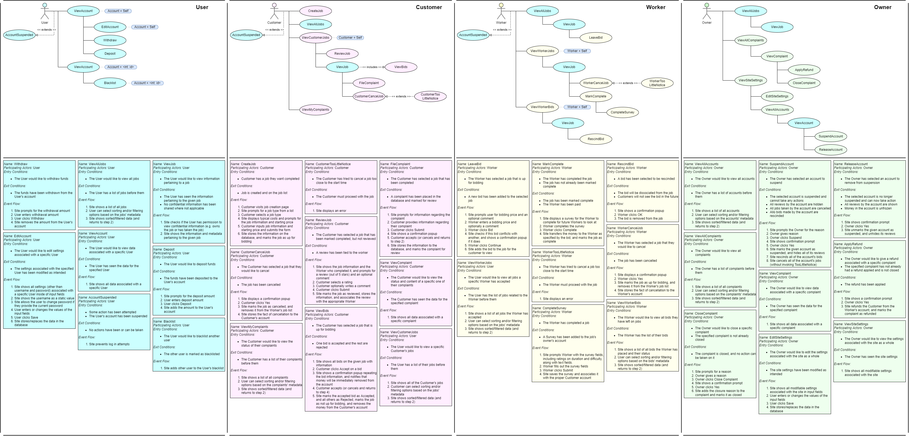
Use Cases

Slide 3
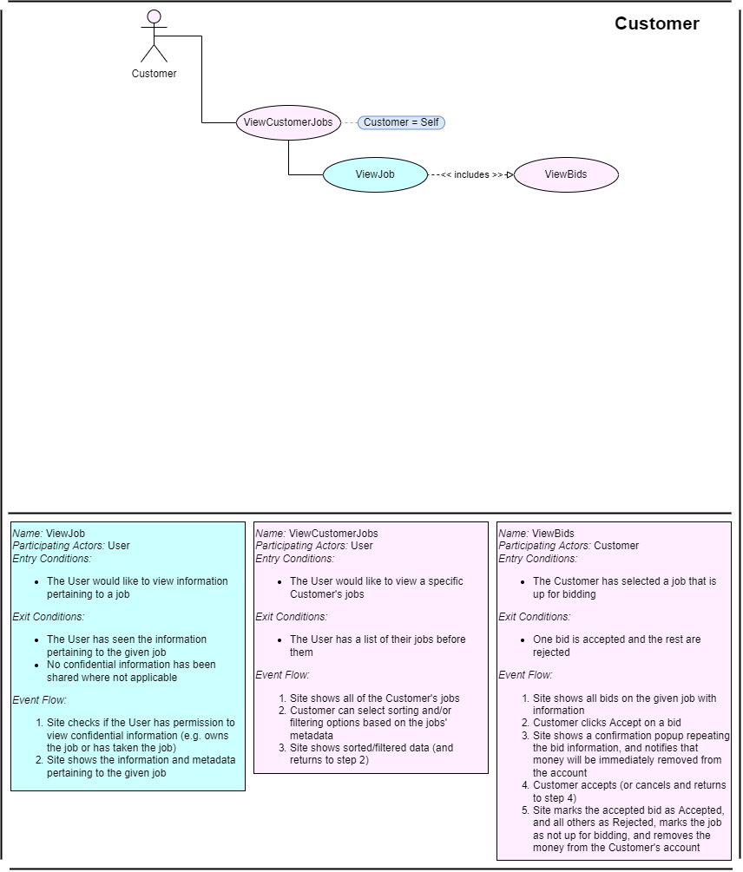
Accept Bid

Slide 4
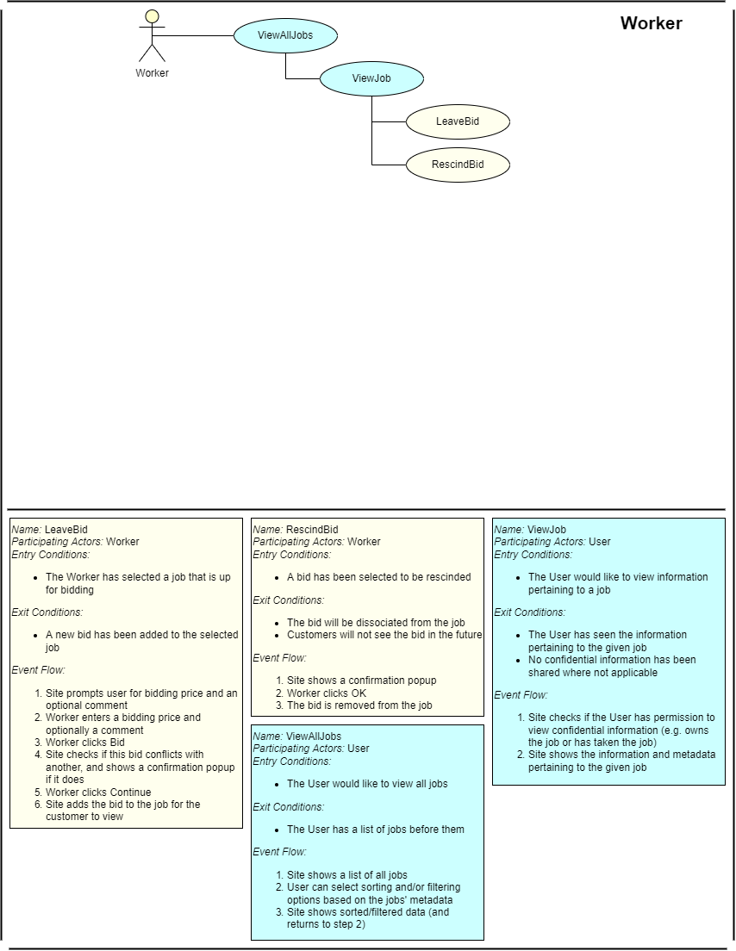
Leave Bid

Slide 5
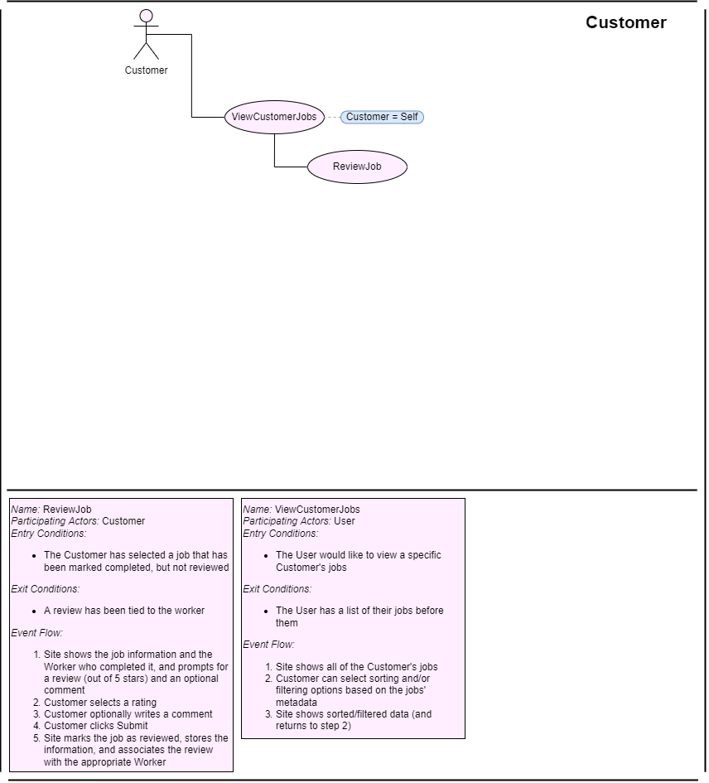
Review Worker

Slide 6
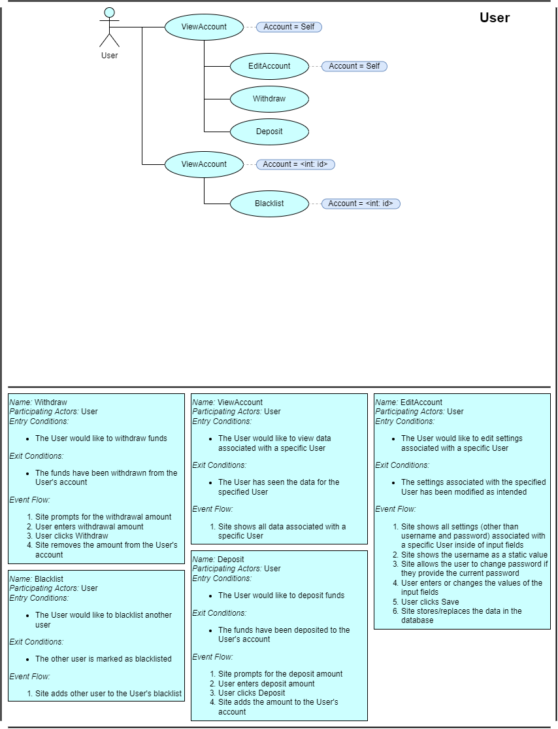
View Account

Slide 7
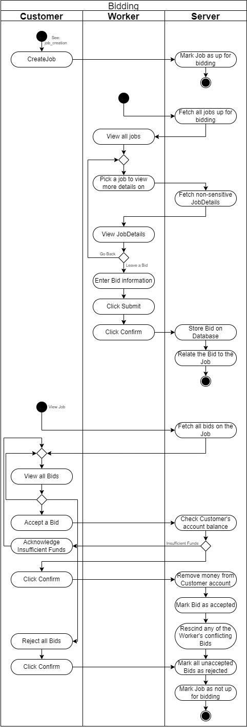
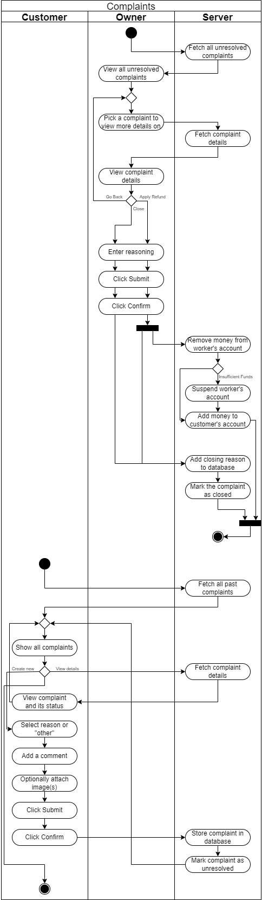
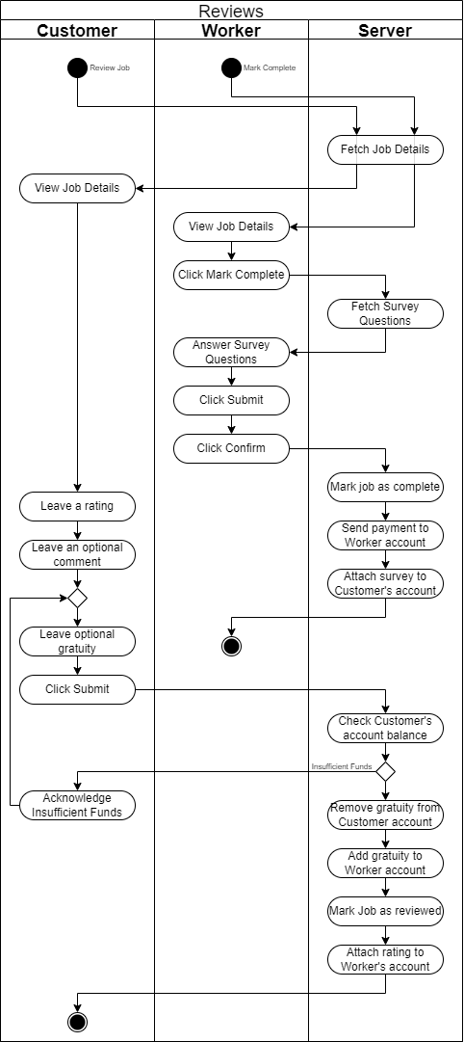
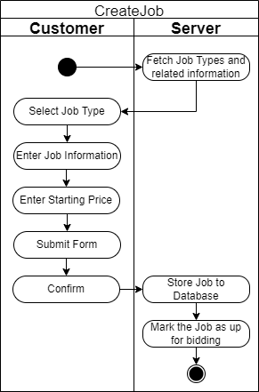
Activity Diagrams

Slide 8
Bidding

Slide 9
Reviews

Slide 10
Complaints

